Slide 1










Salary Prediction App
A Machine Learning-Based Web Application
👨‍💻 Developed by: Swapnil Kobi
🧑‍🏫 Guide: Himanshu Souda

Slide 2





















Introduction & Objective
Purpose
Key Input Features
A machine learning-based web application designed to estimate an employee's salary based on key attributes, automating processes that traditionally require manual analysis.
Years of Experience
Education Level
Job Title
Department
Key Benefits
How It Works
Beneficial for HR departments in compensation planning
Helpful for individuals in job market analysis
User Inputs
ML Model
Predicted Salary
Streamlines processes that require manual analysis

Slide 3



















Tools & Technologies
Programming Language
Libraries
Python - Core language for development and machine learning
Pandas
Scikit-learn
Matplotlib
Joblib
Framework
Development Tools
Streamlit
Jupyter Notebook
Building interactive web applications
VS Code
GitHub

Slide 4















Project Workflow & Working
1. Data Preprocessing
2. Model Training
3. Saving Artifacts
4. Deployment
Cleaning and preparing raw data, encoding categorical variables using pandas.get_dummies()
Building a regression model using Scikit-learn to learn relationships between attributes and salary
Creating an interactive web application using Streamlit for user interaction
Saving the trained model and preprocessor using joblib for deployment
Workflow Explanation
Data Preprocessing: Transforms raw data into a suitable format for ML models
Saving Artifacts: Preserves the trained model for later use without retraining
Model Training: The model learns patterns from employee attributes to predict salaries
Deployment: Makes the application accessible through a web interface

Slide 5




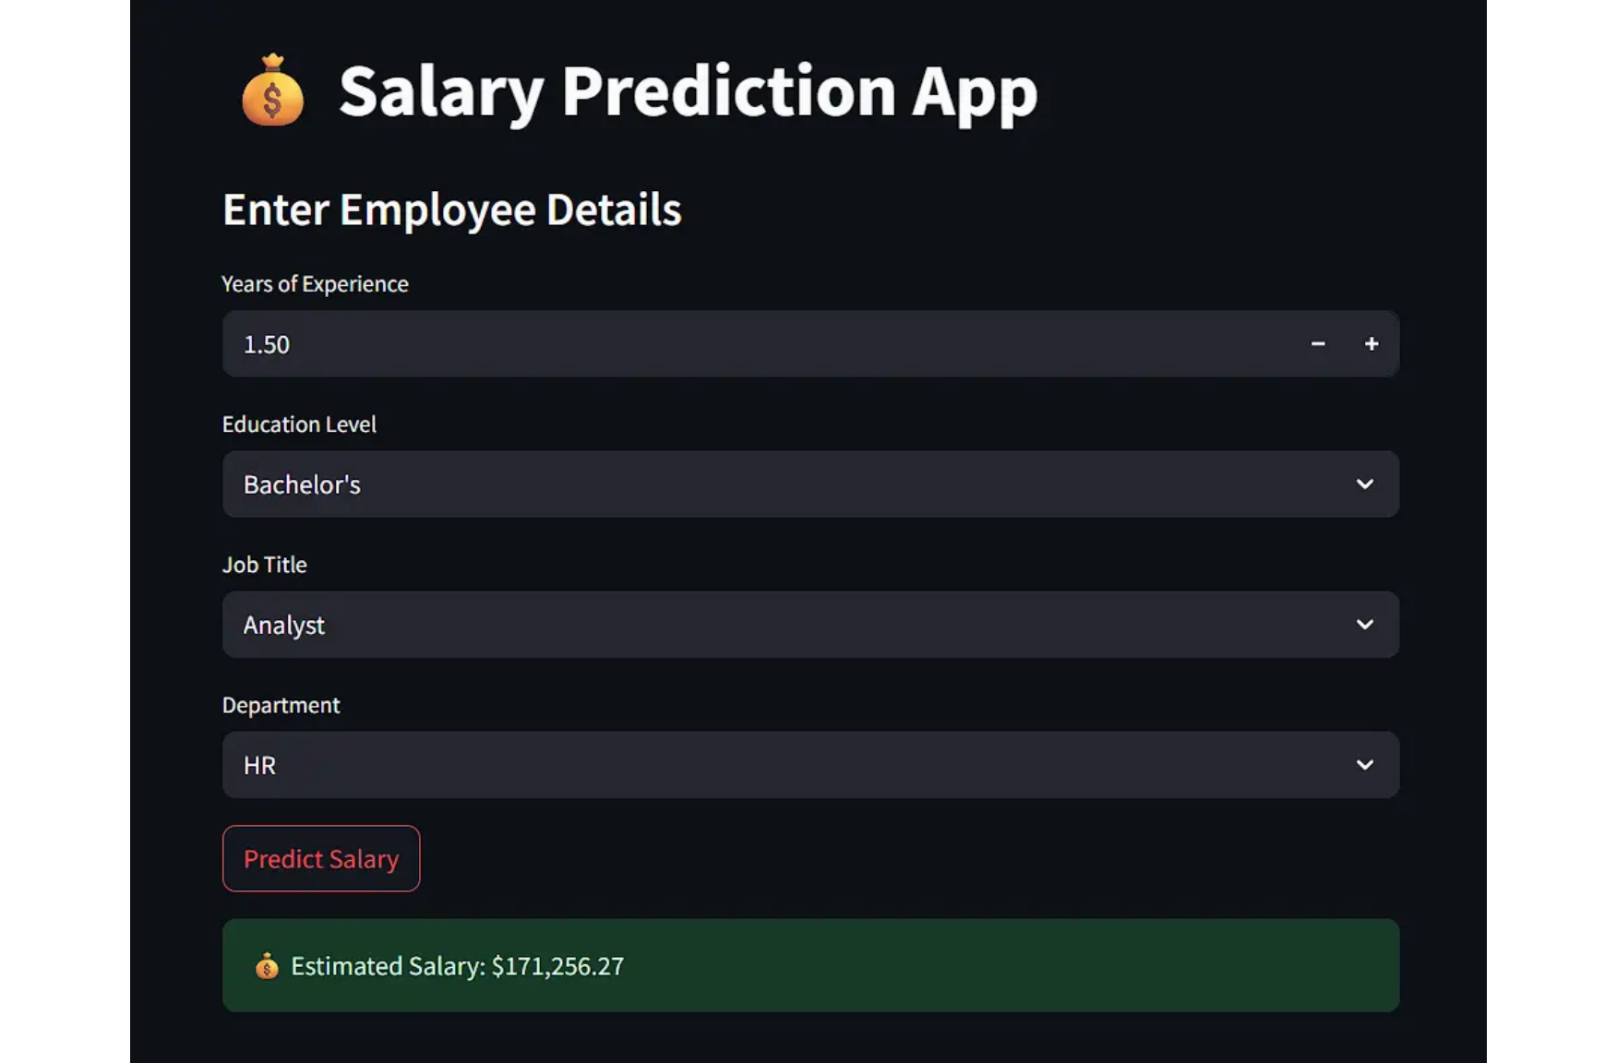








Output Screenshots
The Salary Prediction App provides a user-friendly interface for inputting employee details and displaying estimated salaries.
User Input Interface
Prediction Output
Salary Prediction Results
Employee Details:
Years of Experience: 5.00
Education: Master's
Job Title: Manager
Department: Finance
Predicted Salary:
$278,573.12
Example output: Manager with Master's degree in Finance department
Example input: 1.5 years experience, Bachelor's degree, Analyst in HR

Slide 6
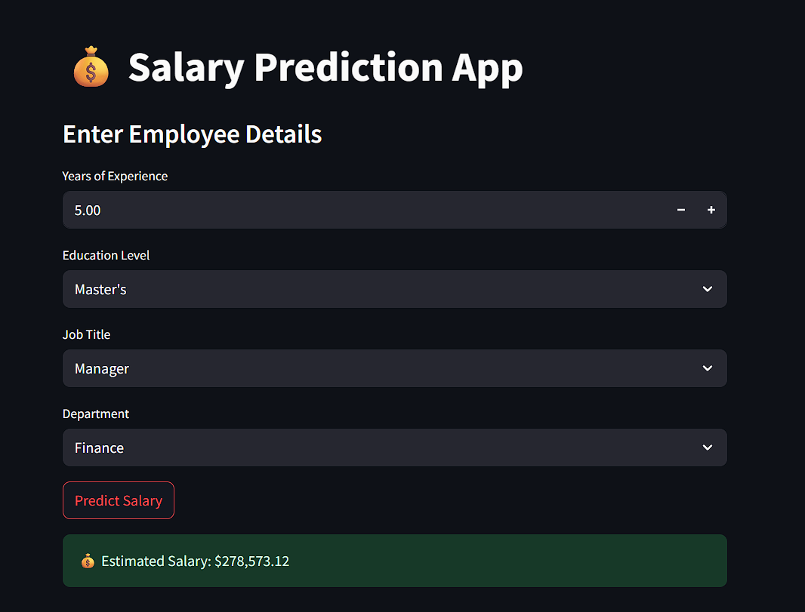



6/8

Slide 7















Applications & Challenges
Applications
Challenges & Solutions
HR Salary Analysis
File Not Found
Helps HR departments benchmark salaries, ensure fair compensation, and inform salary negotiations.
Problem: Model file not found
Solution: Verified working directory
Job Market Research Tools
Feature Mismatch
Equips job seekers and recruiters with insights on salary expectations for different roles.
Problem: Data columns don't match model
Solution: Used reindex() to align columns
Predictive Analytics
Deployment Issues
Enables organizations to forecast future compensation costs and develop competitive salary structures.
Problem: Deployment failures
Solution: Added requirements.txt
7/8

Slide 8




















Future Scope & Project Link
Enhancement Opportunities
Project Repository
Deep Learning Integration
Database Implementation
Enhance model accuracy using advanced neural networks and deep learning techniques
Add database for storing user records and prediction history
GitHub Repository
Access the complete source code and documentation
Visual Analytics
Cloud Deployment
Thank You!
Build interactive dashboards for deeper salary market insights and visual analytics
Deploy on cloud platforms (Streamlit Cloud / AWS) for scalable, accessible service
For questions or collaboration opportunities
swapnilkobi@example.com
8/8

